Slide 1

Sunbird Saral

Slide 2
Agenda
Project Updates
Performance Benchmarking Phases
Backend Performance Benchmarking Infra
Backend Performance Benchmarking Infra Pricing
Demo with latest features
Last two releases overview
Backlog in JIRA
Q&A

Slide 3
Project Updates
Last Two Sprint Updates
Save marks performance changes JIRA ID SS-164
Sonar scans quality gate (Backend and frontend) and code refactoring: JIRA ID SS- 46
New layout configuration for 105 questionsJIRA ID SS-94
Fixed save count issue for multi usersJIRA ID SS-140
Backend code coverage integrated with CICD JIRA ID SS-99
Handwritten digit AI model improvement JIRA ID SS- 13
Work in progress items
Telemetry for app usage analysis. JIRA ID SS-126
Backend performance tuning: JIRA ID SS-7
Load scripting and testing
TFLite model download from firebase: JIRA ID SS-95

Slide 4
Performance Benchmarking Phases
Phase I
Phase II
Phase III
Profiling and fine tuning the code and configurations
Scripts to generate data
Setup Load Testing Tool (JMeter) with scripting
Setup monitoring tools/Configurations
Load test with minimal users say 100 users on Dev as dry run.
Identify bottlenecks and finetune the code and configuration
Publish the Metrics in multiple iterations
Setup Cloud Environment
Run Load Testing (JMeter) Scripts for 10,000 Users
Finetune the configurations , code to scale
Publish the Metrics in multiple iterations
Run Load Testing Scripts(JMeter) with U.P scale data
Finetune the configurations , code to scale
Publish the Metrics

Slide 5
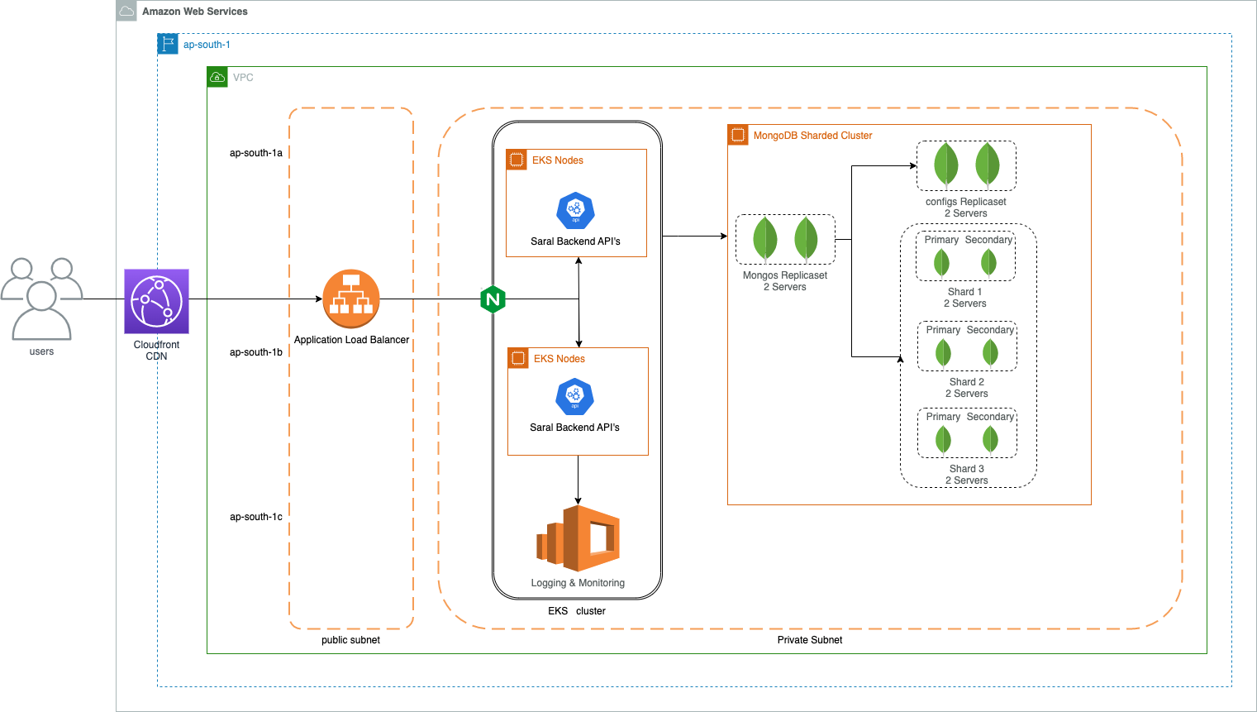
Backend Performance Benchmarking Infra

Slide 6
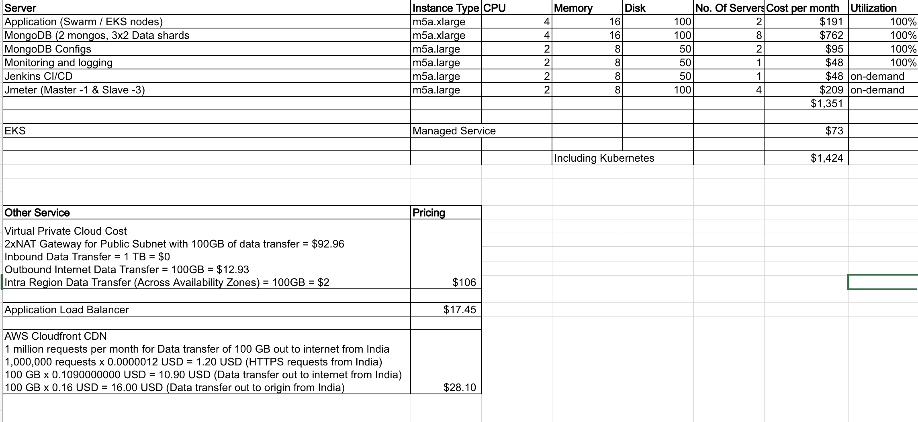
Backend Performance Benchmarking Infra Pricing

Slide 7
Overview
Problem
To enhance learning opportunities for 200 million children across india , state educational boards to digitize assessment results from numerous public schools across state on regular basis to analyze the data and run campings as needed. Key challenges are the manual data entry , technology availability in remote parts of the state.
Solution
Android mobile app with embedded AI/ML as edge location solution to digitize/phygitize the data from the field.
Handwritten digits and OMR detection capabilities
Fully leverages mobile compute power to predict and digitize the data from physical form.
Specification to represent and detect physical sheets
Highlights
Easily configurable to cover non-academic use cases like skill development.
Rolled out in multiple districts of u.p successfully and scheduled for a statewide rollout
Value-add features
Multi-Tenant branding,screen customization
Auto-Sync with backend
Mobile local storage support to operate in offline mode
Easy to generate and configure new layout sheets
Multi-Student , Multi-Page support
Saral SDK - Reusable accelerator
Review Feature

Slide 8
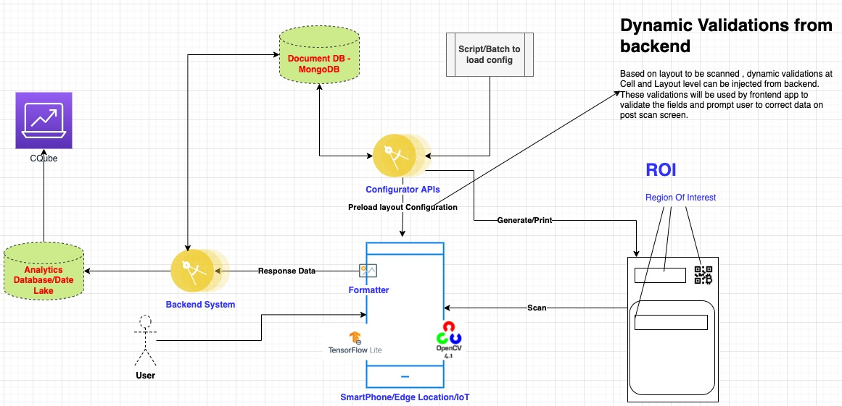
Architecture

Slide 9
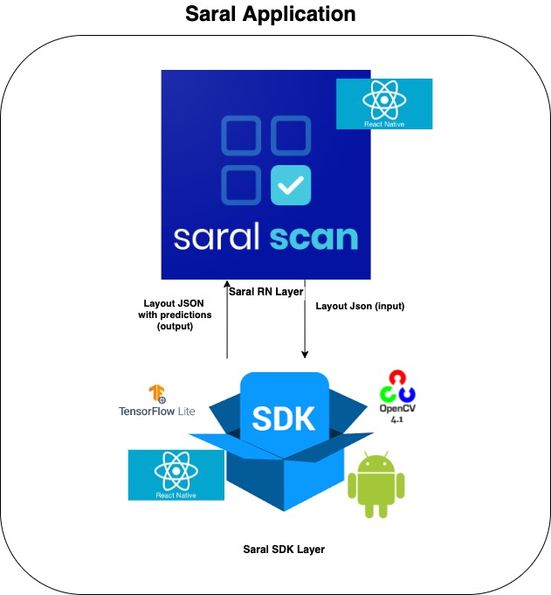
Packaging

Slide 10












Tech Stack
ResNet

Slide 11
Supported Phygitization/Extraction methods
OMR (Optical Mark Recognition) filled with pencil/pen with any color
Handwritten Digits
Handwritten Alphanumeric Block Letters

Slide 12
Saral Documentation & Videos
https://saral.sunbird.org/
Sunbird Saral Youtube Videos

Slide 13
Demo with latest features

Slide 14
Last two releases overview

Slide 15
Backlog in JIRA

Slide 16
Q&A

Slide 17
Thank you!

